Slide 1



Interactive Therapy Art
Present By:
Abdulrahman Alghaligah
Ahmed Majed Alotaibi
Fahad Abdulaziz Alshaya

Slide 2
Why is this project ?
Providing a board that understand user’s current emotion.
Achieve 2-way interactive.
Taking the role of therapist.
Choosing the appropriate colors

Slide 3
Ai
Using VQGAN
Load Pre-trained neural networks
Building Machine learning model that generate text from audio

Slide 4
Art
Showing all the stages of the painting
Selecting the right colors that match each emotion
Selecting the right style for each emotion

Slide 5
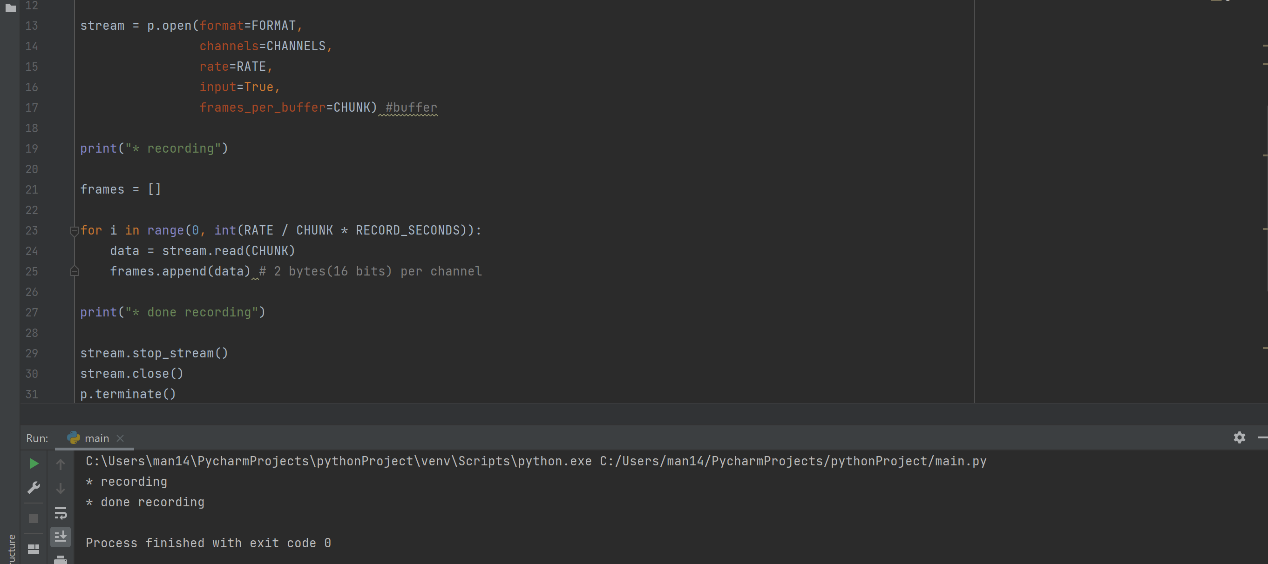
Result

Slide 6
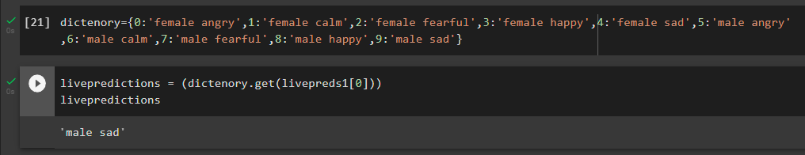
Result

Slide 7
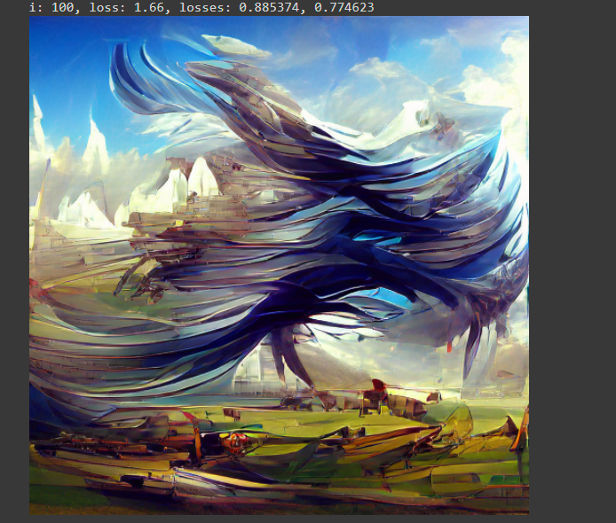
Result

Slide 8
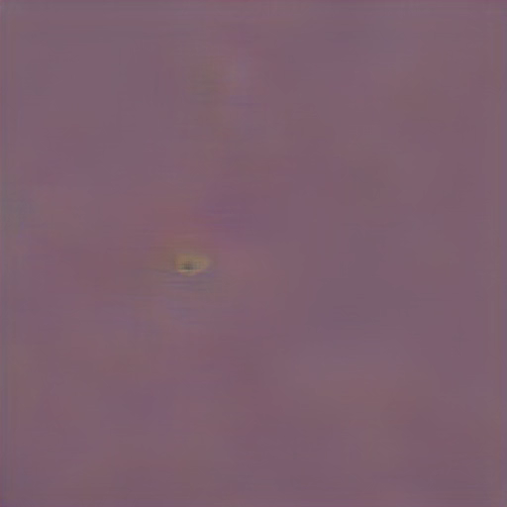

Slide 9
Future plane
Attach the model to the board
Convert Machine learning model to Tiny Machine learning(TinyML) Model
Using more emotional colors depends on the emotions and gender
Paint the correct draw depends on user’s speech
Improving 2-way interaction

Slide 10
Thank you for listening!

